Slide 1
Object Oriented Programming I: Lecture 7- Inheritance
Ahmed Imteaj
Lecturer
Dept. of CSE, IIUC

Slide 2
Inheritance
Inheritance is the process of creating new classes, called derived classes, from existing or base classes. The derived class inherits all the capabilities of the base class but can add embellishments and refinements of its own. The base class is unchanged by this process.
The general form for inheritance is:
class derived-class : access base-class
{
// body of new class
}

Slide 3
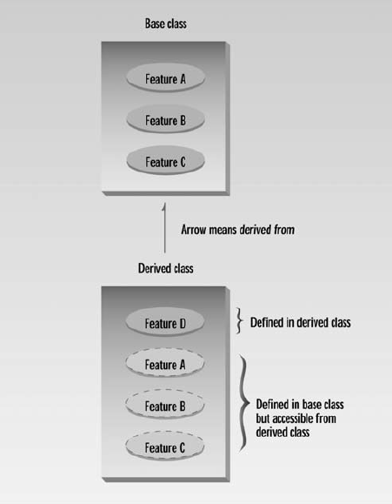
Inheritance Relationship

Slide 4
Benefits of Inheritance
Inheritance is an essential part of OOP. Its big payoff is that it permits code reusability.
Once a base class is written and debugged, it need not be touched again, but, using inheritance, can nevertheless be adapted to work in different situations.
Reusing existing code saves time and money and increases a program’s reliability.
Inheritance can also help in the original conceptualization of a programming problem, and in the overall design of the program.
An important result of reusability is the ease of distributing class libraries. A programmer can use a class created by another person or company, and, without modifying it, derive other classes from it that are suited to particular situations.

Slide 5
Type of Inheritance
When deriving a class from a base class, the base class may be inherited through public, protected or private inheritance. The type of inheritance is specified by the access-specifier.
Public Inheritance: When deriving a class from a public base class, public members of the base class become public members of the derived class and protected members of the base class become protected members of the derived class. A base class's private members are never accessible directly from a derived class, but can be accessed through calls to the public and protected members of the base class.
Protected Inheritance: When deriving from a protected base class, public and protected members of the base class become protected members of the derived class.
Private Inheritance: When deriving from a private base class, public and protected members of the base class become private members of the derived class.

Slide 6
Derived Class and Base Class
When creating a class, instead of writing completely new data members and member functions, the programmer can designate that the new class should inherit the members of an existing class.
This existing class is called the base class, and the new class is referred to as the derived class.

Slide 7
Public and Private Inheritance: Access Combinations
Functions in the derived classes can access protected and public data in the base class. Objects of the derived classes cannot access private or protected members of the base class.
The keyword public specifies that objects of the derived class are able to access public member functions of the base class.
The alternative is the keyword private. When this keyword is used, objects of the derived class cannot access public member functions of the base class. Since objects can never access private or protected members of a class, the result is that no member of the base class is accessible to objects of the derived class.

Slide 8
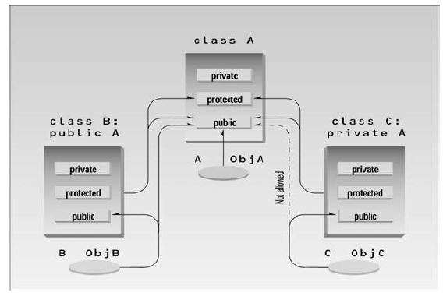
Public and Private Inheritance: Access Combinations
Objects of the publicly derived class B can access public members of the base class A, while objects of the privately derived class C cannot; they can only access the public members of their own derived class. This is shown in below:

Slide 9
Inheritance Example
#include <iostream>
using namespace std;
class A //base class
{
private:
int privdataA;
protected:
int protdataA;
public:
int pubdataA;
};
class B : public A //publicly-derived class
{
public:
void funct()
{
int a;
a = privdataA; //error: not accessible
a = protdataA; //OK
a = pubdataA; //OK
}
};
class C : private A
//privately-derived class
{
public:
void funct()
{
int a;
a = privdataA; //error: not accessible
a = protdataA; //OK
a = pubdataA; //OK
}
};

Slide 10
Inheritance Example
int main()
{
int a;
B objB;
a = objB.privdataA; //error: not accessible
a = objB.protdataA; //error: not accessible
a = objB.pubdataA; //OK (A public to B)
C objC;
a = objC.privdataA; //error: not accessible
a = objC.protdataA; //error: not accessible
a = objC.pubdataA; //error: not accessible (A private to C)
return 0;
}

Slide 11
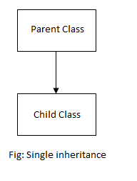
Single Inheritance
When a single class is derived from a single parent class, it is called Single inheritance. It is the simplest of all inheritance. For example,
Animal is derived from living things
Car is derived from vehicle

Slide 12
Single Inheritance
Syntax of Single Inheritance
class base_classname {
properties; methods;
};
class derived_classname : visibility_mode base_classname
{
properties; methods;
};

Slide 13
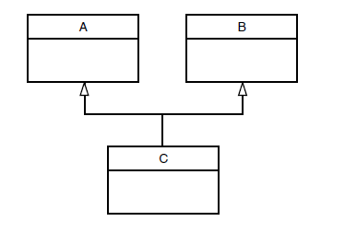
Multiple Inheritance
A class can be derived from more than one base class. This is called multiple inheritance.
Here is the extended syntax:
class derived-class: access baseA, access baseB....
Figure shows how this looks when a class C is derived from base classes A and B.

Slide 14
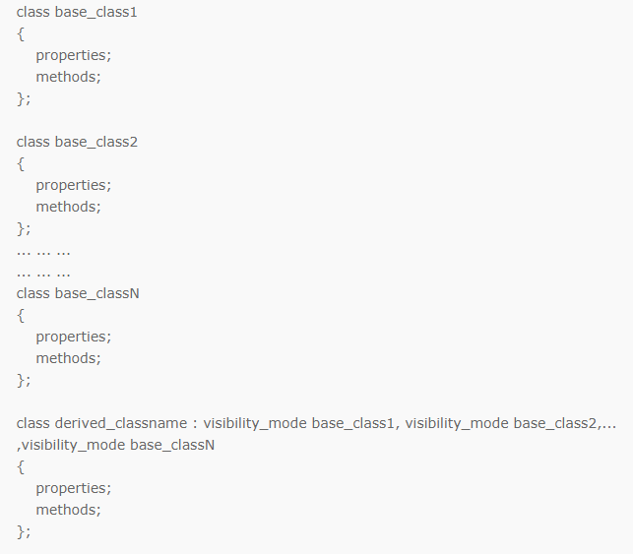
Syntax of Multiple Inheritance

Slide 15
Multiple Inheritance
#include <iostream>
using namespace std;
// Base class Shape
class Shape {
public:
void setWidth(int w)
{ width = w; }
void setHeight(int h)
{ height = h; }
protected:
int width;
int height;};
// Base class PaintCost
class PaintCost {
public:
int getCost(int area) {
return area * 70;
}};
// Derived class
class Rectangle: public Shape, public PaintCost {
public:
int getArea() {
return (width * height);
}
};
int main() {
Rectangle Rect;
int area;
Rect.setWidth(5);
Rect.setHeight(7);
area = Rect.getArea();
cout << "Total area: " << Rect.getArea() << endl;
cout << "Total paint cost: $"<< Rect.getCost(area) << endl;
return 0;
}
Notes:
Output: Total area: 35 Total paint cost: $2450

Slide 16
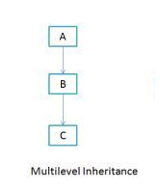
Multilevel Inheritance
When a class is derived from a class which is also derived from another class, i.e. a class having more than one parent classes, such inheritance is called Multilevel Inheritance.
If we take the example of below diagram then class C inherits class B and class B inherits class A which means B is a parent class of C and A is a parent class of B. So in this case class C is implicitly inheriting the properties and method of class A along with B that's what is called multilevel inheritance.

Slide 17
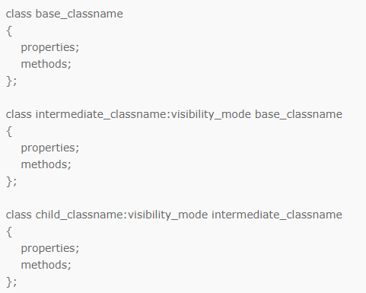
Syntax of Multilevel Inheritance

Slide 18
Multilevel Inheritance
class B : public A
{
};
class C : public B
{
};
int main()
{
C obj;
obj.display();
return 0;
}
#include <iostream>
using namespace std;
class A
{
public:
void display()
{
cout<<"Base class content.";
}
};

Slide 19
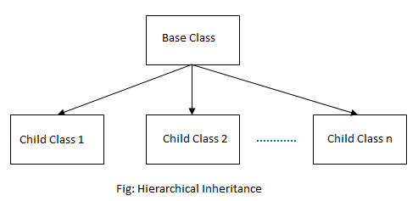
Hierarchical Inheritance
When more than one classes are derived from a single base class, such inheritance is known as Hierarchical Inheritance.
For example,
Civil, Computer, Mechanical, Electrical are derived from Engineer.
Natural language, Programming language are derived from Language.

Slide 20
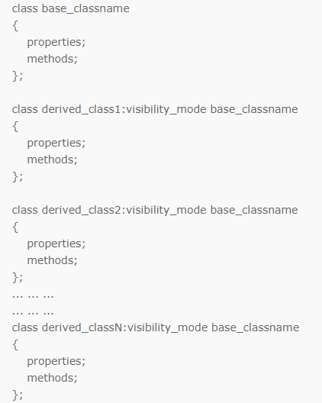
Syntax of Hierarchical Inheritance

Slide 21
Virtual Base Classes
Virtual base class is a way of preventing multiple "instances" of a given class appearing in an inheritance hierarchy when using multiple inheritance.
Class Lecture

Slide 22
Constructor in Derived Classes
While using constructors during inheritance, is that, as long as a base class constructor does not take any arguments, the derived class need not have a constructor function. However, if a base class contains a constructor with one or more arguments, then it is mandatory for the derived class to have a constructor and pass the arguments to the base class constructor.
Remember, while applying inheritance, we usually create objects using derived class. Thus, it makes sense for the derived class to pass arguments to the base class constructor.
When both the derived and base class contains constructors, the base constructor is executed first and then the constructor in the derived class is executed.

Slide 23
Constructor in Derived Classes
#include <iostream>
using namespace std;
class Base
{
public:
int x;
Base(int i)
{
x = i;
cout << "Base Parameterized Constructor";
}
};
class Derived : public Base
{
public:
int y;
Derived(int j) : Base(j)
{ y = j;
cout << "Derived Parameterized Constructor";
}
};
int main()
{
Derived d(10) ;
cout << d.x ; // Output will be 10
cout << d.y ; // Output will be 10
return 0;
}

Slide 24
Nesting of Classes
A nested class is a class which is declared in another enclosing class. A nested class is a member and as such has the same access rights as any other member. The members of an enclosing class have no special access to members of a nested class.

Slide 25
Nesting of Classes
#include<iostream>
using namespace std;
class A {
int x;
public:
class B {
public:
void display() {
A b;
b.x=5;
cout<<"C++"<<b.x;
}
};};
int main()
{
A::B d;
d.display();
return 0;
}

Slide 26
Thank You!!

